Slide 1
Programming With C and Python For Newbies
Day 12: Course summary,Final projects and Application areas of programming in the real world

Slide 2

Final Projects
A simple calculator
A simple to-do list
Weight Converter

Slide 3

Application areas of Programming(Jobs)
Technology and software are infiltrating nearly every industry. That’s why the demand for tech professionals is only increasing. In fact, there was an 18% increase in software engineer job postings from August to October of last year alone, according to Indeed. With so many companies investing in technology and software, it’s never been a better time to become a tech professional.
Here are the most in-demand skills you should consider if you want to enter this field.

Slide 4
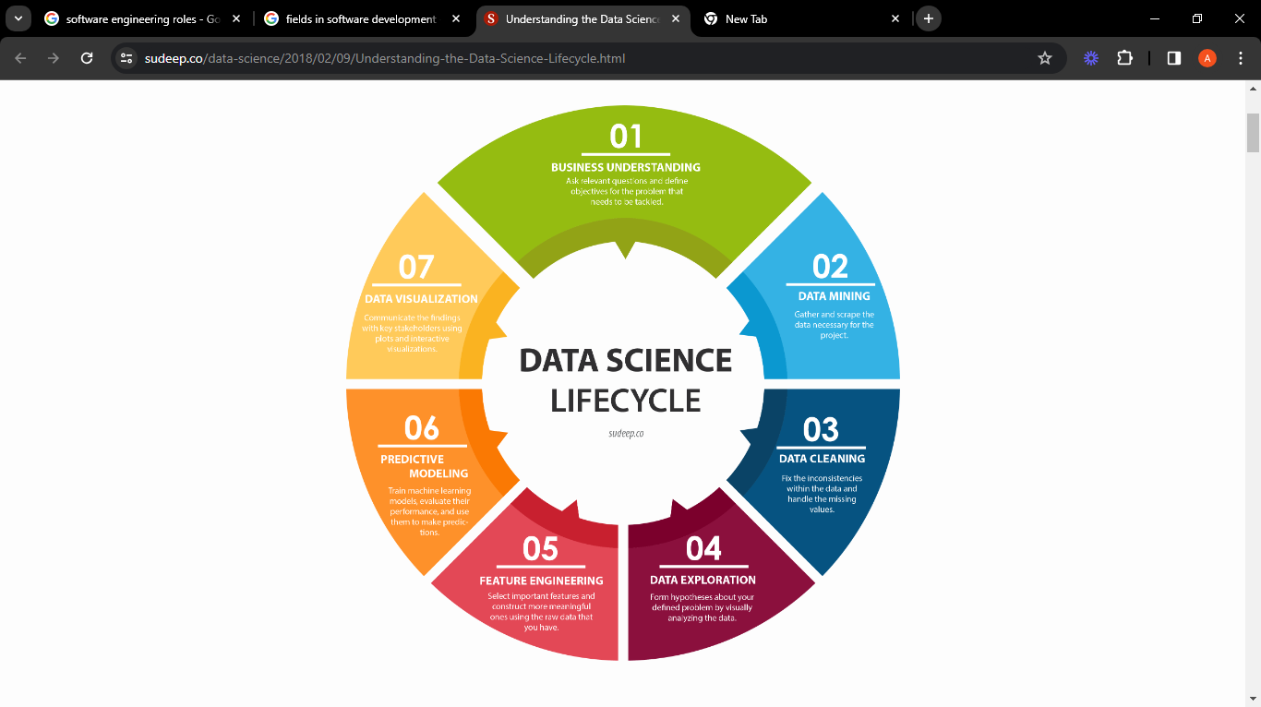
Data Science
Data scientists use statistics and algorithms to find insights into data and to help companies make better decisions based on data analysis.
Average Salary: $250,000
Skills: Python, R, Machine learning algorithms,
Good in maths and statistics,
Tensorflow and scikit libraries

Slide 5
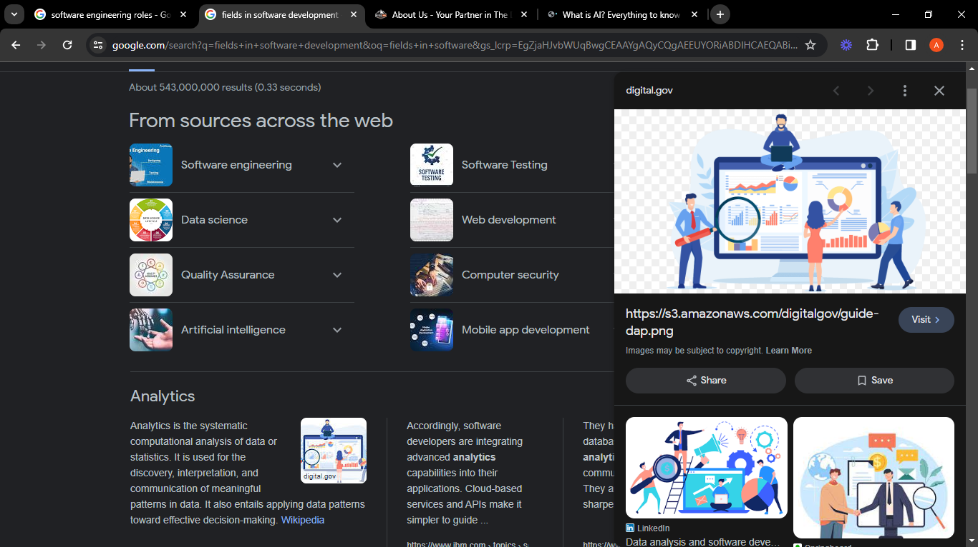
Data Analysis
A data analyst analyses data sets to find ways to solve problems relating to a business's customers. A data analyst also communicates this information to management and other stakeholders.
Average Salary: $157500
Skills: Python, Tableau, PowerBI, Good in maths and statitistics, Numpy and Pandas libraries

Slide 6
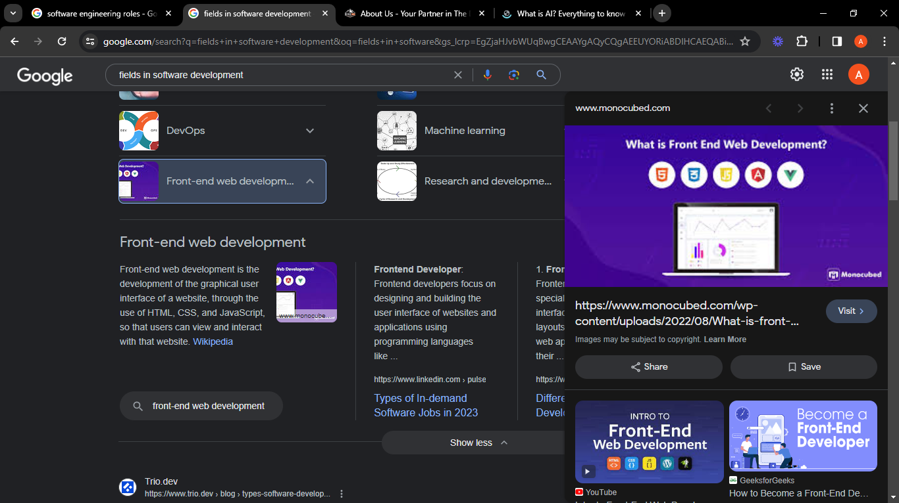
Front-end Web development
A front-end developer is a type of software developer who specializes in creating and designing the user interface (UI) and user experience (UX) of websites and web applications
Average Salary: $112,169
Skills : Html, CSS, Javascript, Web APIs, URLs,HTTP etc

Slide 7

Back-end Web development
Back-end developers are the experts who build and maintain the mechanisms that process data and perform actions on websites. Unlike front-end developers, who control everything you can see on a website, back-end developers are involved in data storage, security, and other server-side functions that you cannot see.
Average Salary:1 02,000$
Skills: Python, Php, SQL, Git, Data structures and algorithms.

Slide 8
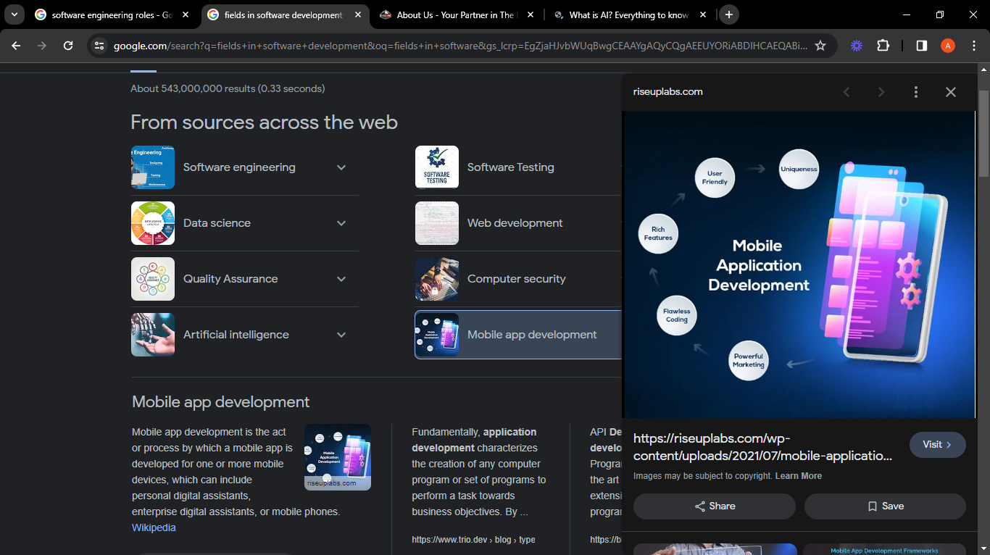
Mobile Application Development
Mobile app development is the act or process by which a mobile app is developed for one or more mobile devices.
Average Salary: $104,045
Skills : Kotlin, Objective-C, Swift, Flutter, Dart , Javascript etc

Slide 9
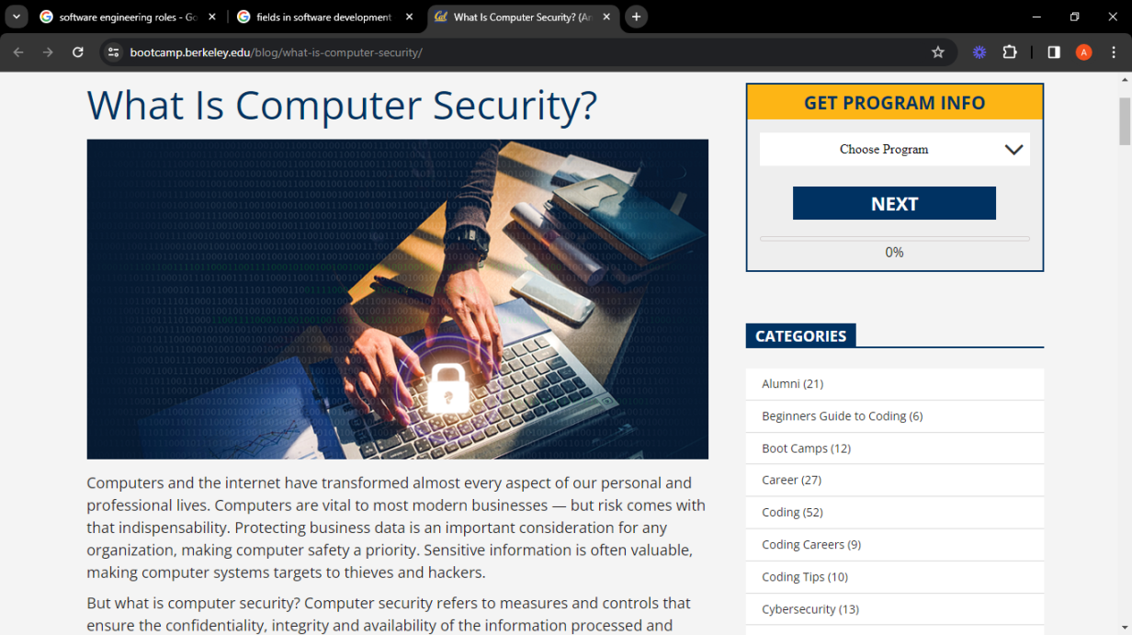
Cyber Security
Computer security, cyber security, digital security or information technology security (IT security) is the protection of computer systems and networks from attacks by malicious actors that may result in unauthorized information disclosure, theft of, or damage to hardware, software, or data, as well as from the disruption or misdirection of the services they provide.
Average Salary: $122,890
Skills : Scripting languages eg Bash, Python, Machine learning, Computer architecture, operating systems, network management etc

Slide 10

Cloud Computing
Cloud computing is the delivery of computing services—including servers, storage, databases, networking, software, analytics, and intelligence—over the Internet ("the cloud") to offer faster innovation, flexible resources, and economies of scale.
Average Salary: $124,528
Skills: Python, Machine learning,computer architecture, network management etc

Slide 11
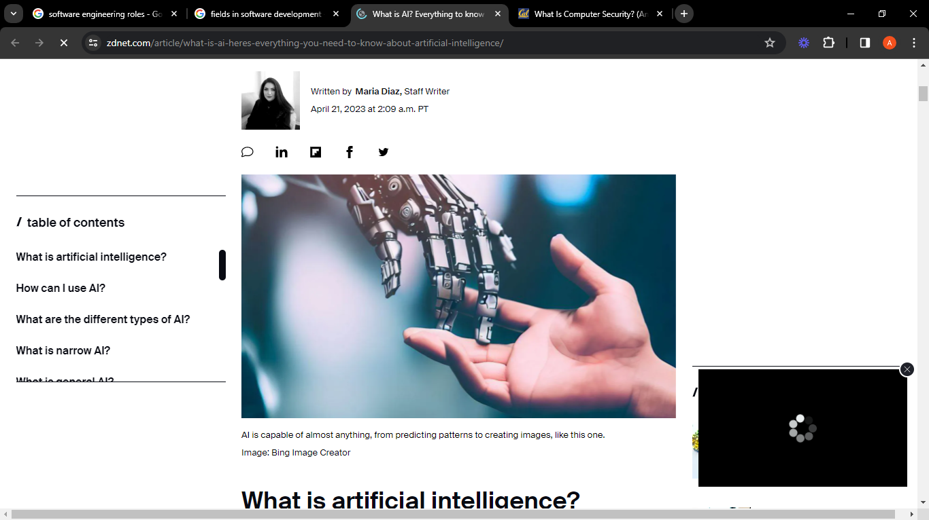
Other fields that requires programming:
Full stack developer
Machine learning
and Artificial intelligence
Video game development
Ethical hacking
Python programmer
Programming Tutor

Slide 12
Tech fields that do not require coding:
UI/UX design
Technical writing
Product manager
Content manager
IT support specialist

